Slide 1
Dr. C.R. Krishna Kumari Amma Prof. and Head ,Dept. of Materia Medica
Pulsatilla nigricans

Slide 2
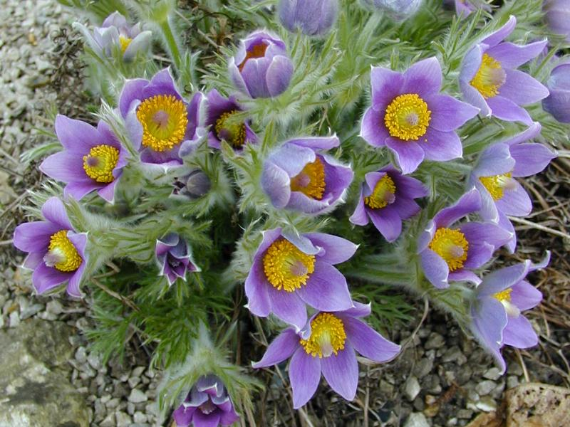
Pulsatilla

Slide 4
Common Names :-
Anemone pratensis,
Pasque Flower,
Wind Flower.
Natural Order :- Ranunculaceae.
Tincture of entire fresh plant when in flower.
Grows in plains and pasturelands of central and Northern Europe.

Slide 5
It is a small and delicate stem which bends one way or another according to the direction of the prevailing wind.
Constitutional type – Women and children predominantly. Delicate & pretty & a physique that can fluctuate easily in weight loss & weight gain.
She is the most innocent of the constitution types.

Slide 6
Symptoms – Characteristically changing;
like pains wander from one part of the body to another,
shift rapidly from joint to joint,
appear on one side or other,
with no two chills, no two stools, no two attacks alike.

Slide 7
Circulation – unstable; flushes up or blushes easily.
Individual can alter from bright & lively to tired and droopy.
Also like a gust of wind, pains come on suddenly – rise abruptly on 1st motion or subside gradually & pt. finds relief in gentle motion – walking or rocking back & forth.

Slide 8
Like a delicate flower, puls cannot tolerate heat of a warm house or stuffiness of a close atmosphere – requires fresh air to preserve her strength & well – being.
The Pulsatilla plant grows primarily in dry sandy soil, so the puls nature has little need for water, she is thirstless even the mouth is dry and can withstand long periods without drinking water.
INFACT SHE MUST REMIND HERSELF TO DRINK .

Slide 9
Pulsatilla Child :- Mildness
Highly emotional.
Devoted. Affectionate & mild, providing their emotional needs are met by their parents.
Tend to demand instant gratification; if they feel deprived will cry & be petulant until their needs are met.
When hurt-physically or emotionally-cries.
No attempt to disguise her pain. Once crying is over, pain forgotten immediately.

Slide 10
Little children selfish does not share their things ever with the close friends
Look for emotional security
Emotional insecurity makes them selfish. Emotional needs – priority, if not met, create a scene to be noticed.
Whines and moans when unhappy, to attract attention
As long as loved - soft mild and contended.

Slide 11
Puls child - dependent on parents.
Anxious if parents out of sight.
Stick to parents in public
Fond of physical contact - children or adults.

Slide 12
Child demonstrates affection through hugs and kisses, climbs on mother’s lap, cuddles there & sits quietly.
In her need to be physically close to those she loves, she instinctively assumes a sweet acceptable manner.
Family pet.

Slide 13
When reprimanded – lays her head on mother’s shoulder, laces her arms around mother’s neck & apologizes, because she is completely sincere, devoid of false pride & does not bear grudges.
Avoid quarrels – do everything in their power to maintain good relations.

Slide 14
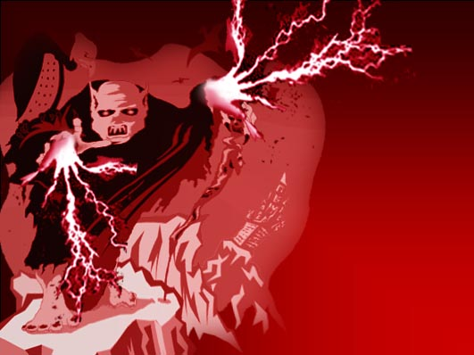
Away from home - timid with strangers; hold back and assess people if they are safe and friendly or not.
Highly personal and fussy about her preferences visual beauty and taste of her favorite food, has to be her own way.
Fear - when they feel insecure
fear of dark, ghosts.

Slide 15
Adult Pulsatilla – Chief concern revolve around her loved ones – life is devoted to her loved ones.
Puls women do not even consider their individuality until they are left suddenly without their loved ones.
Emotional instability :- unstable - prone to all manner of emotional state- brought about by threat to her relationships with loved ones, or by lack of loving relationship.
Crying - most frequent response to emotional pain- gentle.

Slide 16
Emotional Hysteria.
Confusion – if she is given some work which she can’t do. She will avoid such works in future
Mind – Lazy. Not interested in logical rational things. Interested in things related to love relationship and romance.

Slide 17
SWEETNESS :-
Mild, good tempered and sensitive to other’s feelings.
CHILDREN - responsive shy and easy to handle.
ADULT - easy to get along with.
Sweet manner, observable in their pretty facial
features, smiles &
gestures or soft pleasing voice.
- Good and obliging child,
who seeks affection.
- Not prone to argue.
- Plays better with
her siblings,get along
well.

Slide 18
Pulsatilla lady - likes being fussed over & is content to pass even the simplest responsibilities on to others, but she'll graciously thank those who help her.
At other times she selfishly expects others to care for her, feels unappreciated if they do not can be jealous possessive of other’s affection.

Slide 19
Despite sweet looks & manner, she is not all sugar. Even though the puls plant sways along the gust of wind, the roots are firm & stronger.
At work, she is open to suggestions & responsive to the needs of colleagues or an employee.
Her sweetness is also exhibited in the desire & capacity to make life pleasant for her loved ones.
More rudely others behave – more considerate puls gets.

Slide 20
Dependence – Pulsatilla flower grows in clusters, so must human puls have people around her – for someone to lean on. Fear of being alone – esp. in the evening.
Phosphorus
Wants people as an audience or for stimulus.
Lycopodium / Sulphur
Wants people for someone to impress.
Natrum.Muriaticum
Wants people for someone to help or instruct.
Arsenicum
Wants people for someone to direct

Slide 21
In children – dependence manifested in actual clinging- Child hangs on to mother’s dress in public – peeping out from a safe point.
Puls boys – girlish, fear of dark or of being alone,
even though outgrown these
childhood characters, they still remain soft.
Puls dependence does at times prevent her from maturing. They retain childish behaviour.

Slide 22
Puls Puberty – resistance to psychological maturation.
acquires host of unexplained little aches & pains.
reliant on parents support.
In Children – resistance to growing up is manifested as fear of looking up., which causes vertigo.

Slide 23
As the child grows – dependence is directed away from the family, towards the opposite sex.
She has morbid dread of opposite sex, but more often we find that puls responding to her simple sensual needs, is easily attracted to men.
She easily falls in love, can have 3 affairs in an yr.

Slide 24
Puls man acquire support of one or sometimes two strong women to get through life.
Many a long, happy marriages is due to one of the spouses being largely pulsated. Even Lyco would claim to play similar role in marriage with a mere difference that he would be lying.
Puls women basically wants to get married and have children.

Slide 25
Companionability - Inherently friendly; after initial shyness she relates naturally and effortlessly making others feel comfortable in her (accepting) presence.
Sulphur- Male counterpart for sociability
Puls -In her free time wishes to visit fiends.
Tuberculinium - Desire to travel & see new places.
Lachesis – Go on a shopping.
Phosphorus – spend evening at the opera or theatre.
Nat. Mur – be with a close friend., cent a vacation in cottage.

Slide 26
Arsenic - Just stay at home & finally have time to work on his music, painting or writing.
Medorrhinum –spend time at the Seaside.
Sulphur - Be in library.
Flexibility - manifested in two ways, Indecisiveness and through adaptability
Emotionalism - is marked by fluctuation, self-pity & sentimentality, self-pity - noted in tone of baby’s cry .

Slide 27
P – Phlegmatic temperament.
U – Unnatural Brooding.
L – Lachrymal ( least affair throws her off the balance )
S – Silent Peevishness.
A – Amelioration from consolation.
T – Timid, Taciturn.
I – Indecisive.
L – Like April Day, Changeable mood.
L – Low-spirited – fears.
A – Amiable.

Slide 28
Cyclamen- Remedy of Plant kingdom.
Sowbread, Primulaceae.
Situation of cyclamen is that of a women who feels that she has done something wrong or that she hasn’t done her duty and something bad has occurred as a result.
She feels solely responsible for what has happened and feels like a criminal. She cannot reveal the crime to anyone keeps everything within her and tries to rectify things as much as possible. She avoids all social contact, does not talk to anyone and feels totally alone.

Slide 29
Similarities – Cyclamen and
Pulsatilla.
Both are predominantly female remedies.
Both are suited to blondes – pale & anaemic.
Both are thirstless.
Both are weepy & dislike company.
Both present changeability of mental symptoms.
Both desire lemonades & to both pork disagrees.
Both are late sleepers.

Slide 30
Dissimilarities.
Cyclamen
< open air.
Mentally peevish, irritable.
< cold & > warmth.
Menses – too early, too profuse, black & clotted.
Better during flow.
Pulsatilla
> open air.
Mild, Gentle, timid, yielding disposition.
> Cold & < warmth
Menses – too late, pale & scanty
Worse during flow

Slide 31
Kali-sulph - Mineral remedy
Sulphate of potassium K₂SO₄, occurs in lavas.
Schussler’s Pulsatilla.
Main feeling of Kali Sulph person of being disgraced and insulted by the family or group whose support he seeks.
Therefore he constantly makes effort to win their esteem and respect.
He wants that his value in their eyes should rise.
He is industrious and helpful, caring towards and supportive of the group.
He seems independent of the opinion of others. At the same time, he has anger towards the family or group, because he feels insulted by them.

Slide 32
As this feeling gets more intense he becomes discouraged and develops tremendous want of confidence.
He becomes insecure and irresolute.
He is fearful and startles easily.
Also he becomes very sensitive and is easily offended.
Finally, he can become averse to business, indolent and indifferent.
Fear of falling. Very irritable. Anxiety in evening. Mental exertion aggravates. Always in a hurry. Timid

Slide 33
Similarities – Kali. Sulph & Puls.
< symptoms in warm room & evening.
> Open air.
Discharges – yellow, purulent in character.
Pressure & feeling of fullness in stomach.
Pain in limbs worse at night & from warmth better in cool open air.
Migratory or Shifting & wandering Rheumatic pains.
Dissimilarity
Kali Sulph – Burning Thirst.
Puls – Thirstless.

Slide 35
Thank You

Slide 36
Pulsatilla
Kali sulph
cyclamen

